Slide 1
Roe v. Wade, January 22, 1973 A Landmark Reform? Or a Constitutional Disaster?

Slide 2
Table of Contents
1. The Roe v. Wade Supreme Court (3)
2. The Question: Did Roe rob lawful State power? (4)
3. Constitutional law violated (5-10)
3.1 Only Congress makes Federal law (5)
3.2 Congress’s powers are limited (5-6)
3.3 Courts decide cases, NOT legislate (7)
3.4 Courts and law: ONLY Interpret, judicial review (8)
3.5 Dissenter White: Roe abused judicial review (8)
3.6 American judicial review’s origin (9)
3.7 Marbury’s phraseology begs two questions (10)
4. Recover the States’ stolen power! (11-13)
4.1 Past State resistance to Federal action (11)
4.1.a Alien & Sedition Acts, 1798 (11)
4.1.b Dred Scott decision, 1857 (12)
4.2 But what about the Supremacy Clause? (13)
5. Roe v. Wade vs. 14th Amendment, 1868 (14-18)
5.1 The potential conflict (14)
5.2 Roe v. Wade hinges on the definition of “person” (15)
5.3 Bouvier’s 1856 Law Dictionary Definitions (16-17)
5.4 Noah Webster’s 1828 Dictionary definition (18)
5.5. FOETUS, med. jur. ”The unborn child” (19)
6. Actions required: States ignore Roe v. Wade (20-21)
7. Responses expected from the usual people (22)

Slide 3
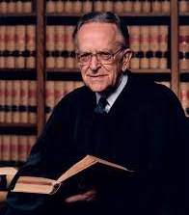
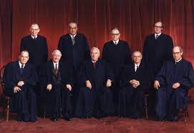
1. The Roe v. Wade Supreme Court
(Justices
White,
Rehnquist
dissented)
Justice Blackmun, Roe’s author
January 22, 1973: Seven unelected Justices struck down
anti-abortion laws in all fifty States: Day of Infamy?

Slide 4
2. The Question: Did Roe rob lawful State power?
Please, Mr. Supreme Court, give the States back the power you stole.
Pretty please?
If so, don’t ever expect thieves to return stolen goods voluntarily, but only by force of law or arms.

Slide 5
3. Constitutional law violated
3.1. Only Congress makes Federal law
(Article 1, Section 1)
Note: All is the very first word after
the Preamble!
3.2. Congress’s powers are limited:
3.2.a. Enumerated powers: Congress’ legislative powers are limited to 18 (Article 1, Section 8)
plus any other specific powers in
the Constitution or Amendments

Slide 6
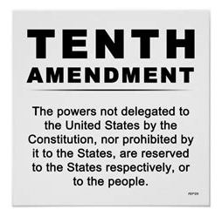
3. Constitutional law violated (continued)
3.2. Congress’ powers are limited (continued):
3.2.b. All other powers are reserved to the States or to the people (10th Amendment). SCOTUS robbed the States of power by adding abortion to the Federal powers, like a freight train suddenly adding a car.
The Feds keep adding to the freight train. Roe v. Wade is arguably the worst!

Slide 7
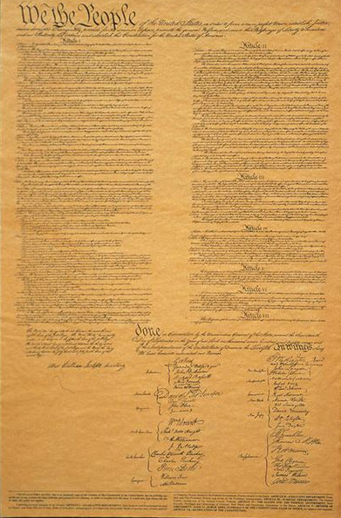
3. Constitutional law violated
3.3. Courts decide cases, NOT legislate
Article 1: Legislative branch (Congress)
Article 2: Executive branch (President)
Article 3: Judicial branch (Supreme Court)
Consider the relative space devoted to the Supreme Court. Sell the Brooklyn Bridge to anyone who thinks the Founders intended it
to be the unelected super-legislature it is
today!

Slide 8
3. Constitutional law violated (continued)
3.4. Courts only interpret and judicially review law
3.5. Dissenter White: Roe abused judicial review
“As an exercise of raw judicial power, the Court perhaps has authority to do what it does today; but, in my view, its judgment is an improvident and extravagant exercise of the power of judicial review that the Constitution extends to this Court.”
What evidence is there that Justice
White’s assessment was correct?

Slide 9
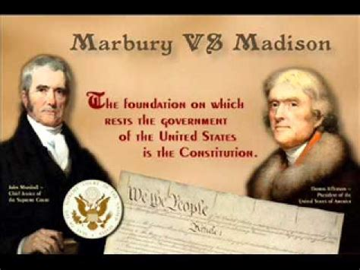
3. Constitutional law violated (continued)
3.6. American judicial review’s origin
Judicial review was historically not expressly set forth in Article 3. Its official origin was Marbury v. Madison (1803):
“The question, whether an act, repugnant to the constitution, can become the law of the land, is a question deeply interesting to the United States; but, happily, not of an intricacy proportioned to its interest. It seems only necessary to recognise certain principles, supposed to have been long and well established, to decide it…”
“(A)n act of the legislature repugnant to the constitution is void…”
https://www.law.cornell.edu/supremecourt/text/5/137

Slide 10
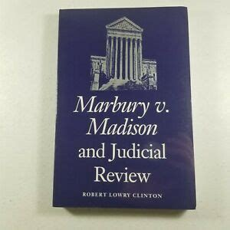
3. Constitutional law violated (continued)
3.7. Marbury’s phraseology begs two questions:
Q1: “…whether an act [or judicial opinion??], repugnant to the constitution, can become the law of the land, is a question deeply interesting to the United States”
Q2: “(A)n act of the legislature [or judicial opinion??] repugnant to the constitution is void…”.
Marbury continues:
“It is a proposition too plain to be contested, that the constitution controls any legislative act [judicial act?] repugnant to it; or, that the legislature [courts?] may alter the constitution by an ordinary act.
Between these alternatives there is no middle ground. The constitution is either a superior, paramount law, unchangeable by ordinary means, or it is on a level with ordinary legislative acts [court opinions?], and like other acts [opinions?], is alterable when the legislature [courts?] shall please to alter it…”

Slide 11
4. Recover the stolen State power!
4.1. Past State resistance to unconstitutional Federal action
4.1.a. Alien & Sedition Acts (1798): The Kentucky and Virginia Resolutions resisted the Alien & Seditions Acts
https://mtsu.edu/first-amendment/article/877/virginia-and-kentucky-resolutions-of-1798
"where powers are assumed which have not been delegated, a nullification of the act is the rightful remedy…”
– Thomas Jefferson
Wrote a letter that criticized President Adams' "unbounded thirst for ridiculous pomp, foolish adulation, and self avarice"
Cong. Matthew Lyon (Vermont)
Newspaper editors critical of Adams

Slide 12
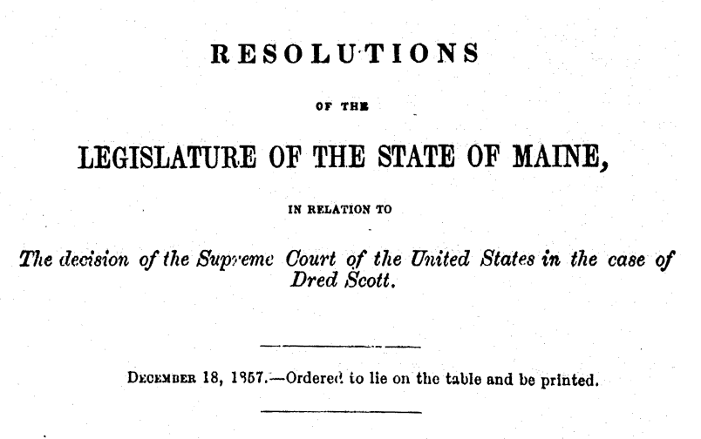
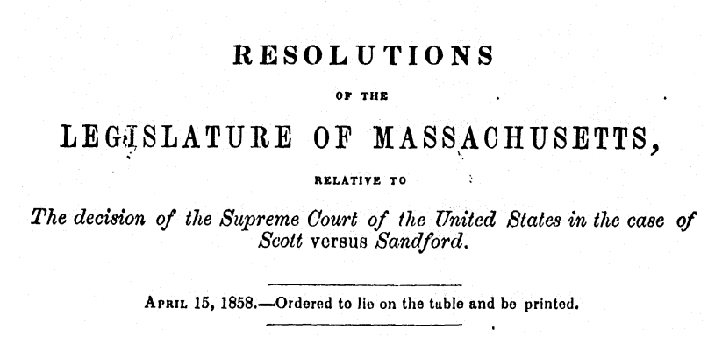
4. Recover the stolen State power! (continued)
4.1. Past State resistance to unconstitutional Federal action (cont.)
4.1.b. Dred Scott decision (1857): Maine and Massachusetts legislatures passed Resolutions that nullified this decision within their respective borders
http://blackfreedom.proquest.com/wp-content/uploads/2020/09/dredscott3.pdf
http://blackfreedom.proquest.com/wp-content/uploads/2020/09/dredscott4.pdf

Slide 13
4. Recover the stolen State power! (continued)
2) But what about the Supremacy Clause?
“This Constitution, and the Laws of the United States which shall be made in Pursuance thereof…shall be the supreme Law of the Land;”
- Article 6, Clause 2, emphasis added
Acts of Congress and Supreme Court decisions are “supreme” only when they follow the Constitution (are “in Pursuance thereof”.

Slide 14
14th Amendment: “All persons born or naturalized in the United States, and subject to the jurisdiction thereof, are citizens of the United States and of the State wherein they reside…” “nor shall any State deprive any person of life, liberty, or property, without due process of law; (emphasis added) Roe v. Wade 410 U.S. 113 (1973): “The appellee and certain amici argue that the fetus is a ‘person’ within the language and meaning of the Fourteenth Amendment...If this suggestion of personhood is established, the appellant's case, of course, collapses, for the fetus' right to life would then be guaranteed specifically by the Amendment…On the other hand...the appellee conceded on reargument that no case could be cited that holds that a fetus is a person within the meaning of the Fourteenth Amendment. (emphases added)
5. Roe v. Wade vs. 14th Amendment, 1868
5.1. The potential conflict
Who is a citizen?
What is a person?

Slide 15
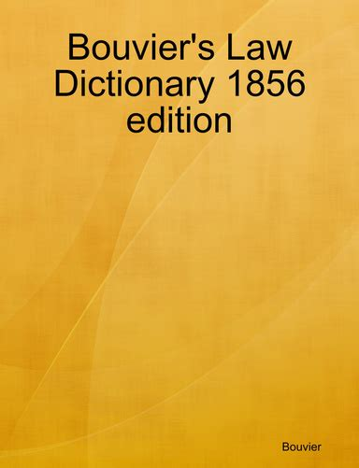
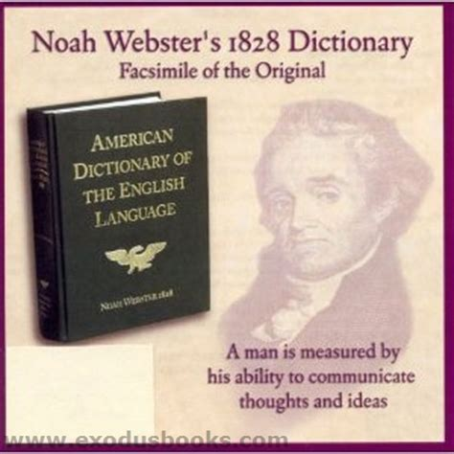
5. Roe v. Wade vs. 14th Amendment, 1868 (continued)
5.2 Roe v. Wade hinges on the definition of “person”
How did authoritative dictionaries of 1868 define “person”?

Slide 16
CHILD, CHILDREN, domestic relations. A child is the son or daughter in relation to the father or mother. 2. We will here consider the law, in general terms, as it relates to the condition, duties, and rights of children; and, afterwards, the extent which has been given to the word child or children by dispositions in wills and testaments. (emphasis added) FOETICIDE, med. jur.¹ Recently, this term has been applied to designate the act by which criminal abortion is produced. 1 Beck's Med. Jur. 288; Guy, Med. Jur. 133. See Infanticide; Prolicide. Does not appear even once in Roe v. Wade. FOETUS, med. jur.¹ The unborn child. The name of embryo is sometimes given to it; but, although the terms are occasionally used indiscriminately, the latter is more frequently employed to designate the state of an unborn child during the first three months after conception, and by some until quickening. (emphasis added) https://constitution.org/1-Constitution/bouv/bouvier_c.htm ¹ Medical jurisprudence
5. Roe v. Wade vs. 14th Amendment, 1868 (continued)
5.3. Bouvier’s 1856 Law Dictionary Definitions
Does the 14th Amendment recognize the unborn as “persons”?

Slide 17
PERSON. This word is applied to men, women and children, who are called natural persons. In law, man and person are not exactly-synonymous terms. Any human being is a man, whether he be a member of society or not, whatever may be the rank he holds, or whatever may be his age, sex, &c. A person is a man considered according to the rank he holds in society, with all the rights to which the place he holds entitles him, and the duties which it imposes. 1 Bouv. Inst. n. 137. (emphasis added) https://constitution.org/1-Constitution/bouv/bouvier_c.htm Comments: 1) A foetus is by defined as an “unborn child”, hence included in Bouvier’s definition of “person”, hence necessarily included, when applicable, to the 14th Amendment (life, but not liberty or property) 2) Had Justice Blackmun or the Roe v. Wade appellee found any case law “that holds that a fetus is a person within the meaning of the Fourteenth Amendment” (Roe v. Wade) – or not – should it not have been decided consistent with the legal definitions of “child”, “foetus”, and “person” when the 14th Amendment was ratified?
5. Roe v. Wade vs. 14th Amendment, 1868 (continued)
5.3 Bouvier’s 1856 Law Dictionary Legal Definitions (continued)
Does the 14th Amendment recognize the unborn as “persons”?

Slide 18
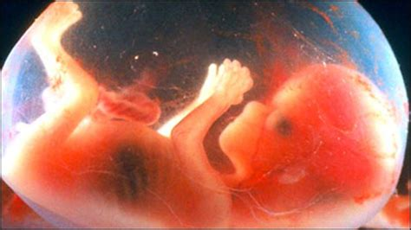
5. Roe v. Wade vs. 14th Amendment, 1868 (continued)
5.4 Noah Webster’s 1828 Dictionary definition
PERSON 1. “An individual human being, consisting of body and soul. We apply the word to living beings only, possessed of a rational nature; the body when dead is not called a person…” http://webstersdictionary1828.com/Dictionary/person
Comments:
1) “Living beings” specifically exclude corpses, but necessarily includes unborn living beings. 2) The 14th Amendment requires birth of citizens, but not of persons, to be consistent with Webster’s 1828 Dictionary.
Citizen? NO
Person? NO
Citizens? YES
Persons? YES
Citizen? NO
Person? YES!!

Slide 19
5. Roe v. Wade vs. 14th Amendment, 1868 (continued)
5.5. FOETUS, med. jur. ”The unborn child”
(Bouvier’s Law Dictionary, 1868
“The appellee and certain amici argue that the fetus is a ‘person’ within the language and meaning of the Fourteenth Amendment...If this suggestion of personhood is established, the appellant's case, of course, collapses, for the fetus' right to life would then be guaranteed specifically by the Amendment.”
CRASH!!
“And great was its fall” (cf. Matthew 7:27)

Slide 20
6. The action required: States ignore Roe v. Wade
“The emperor has no clothes!”
The States should ignore Roe v. Wade, criminalize abortion, and nullify judicial review
Achilles dying from a poisoned arrow
Roe v. Wade is abortion’s Achilles’ heel, not “the law of the land”!

Slide 21
6. The action required: Ignore Roe v. Wade (continued)
So let’s ACT like it!!

Slide 22
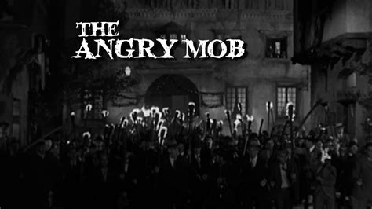
7. Responses expected from the usual people
Judicial activists
Democrats
Legacy media
RINOS
Abortion industry
Pro-lifers
“Nothing to see here!”
“RAGE!! HATRED!!”
And the churches??

